Slide 1

Building Implementation Science Research Capacity to Advance Cancer Prevention and Care in Uganda and Zambia
Heather Wipfli, PI; Jim Arinaitwe, PI, Uganda; Fastone Goma, PI, Zambia

Slide 2

Module 1 Goals
Describe the foundational purpose and current perspectives of dissemination and implementation science.
Recognize the significance of dissemination and implementation research in healthcare and community settings to advancing public health.
Develop familiarity of implementation frameworks and key terminology for applications to public health research and practice.
Evaluate the evidence-base of effective interventions and policies and implementation strategies available for implementation interventions.

Slide 3
Introduction of PIs/Co-PIs
PIs:
  Heather Wipfli, PhD, Professor, Department of Population Science and Public Health and International Relations, University of Southern California
Dr. Jim Arinaitwe, Manager, Center for Tobacco Control in Africa, Makerere University School of Public Health
Dr. Fastone Goma, MD. PhD, Professor, Physiology and Cardiovascular Health, University of Zambia
Co-PIs:
              USC: Cameron Kaplan, Jennifer Tsui
              Uganda: Lynn Atuyambe, David Guwatudde,, Elizeus Ruteberwa, Ronald Kusolo, Ezekiel Musasizi
              Zambia: Richard Zulu, Musawa Mukupa, Masauso , Cosmas Zyambo

Slide 4
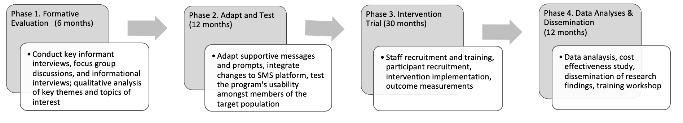
Quit4Life+ Study Overview

Slide 5
Quit4Life+ Specific Aims
Specific Aim 1: To adapt a standard short message service (SMS) tobacco cessation program, previously tested and shown to be effective amongst the general population in low-income countries (LICs), for use with PLWH in LICs. We will carry out formative research on challenges facing PLWH who use tobacco in Uganda and Zambia to ensure adaptations are acceptable, feasible, and appropriate.
Specific Aim 2: To compare the efficacy of our SMS-based program tailored to meet the needs of PLWH (Quit4Life+) to the current standard of care (brief advice to quit) and Nicotine Replacement Therapy (NRT) through a randomized control trial (RCT).
Specific Aim 3: To estimate the cost-effectiveness of Quit4Life+ and NRT by calculating the incremental cost-effectiveness ratios for each intervention arm compared to the standard of care.

Slide 6
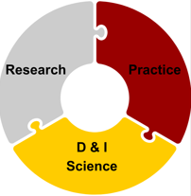


Introduction to Dissemination & Implementation Science for Cancer Prevention

Slide 7
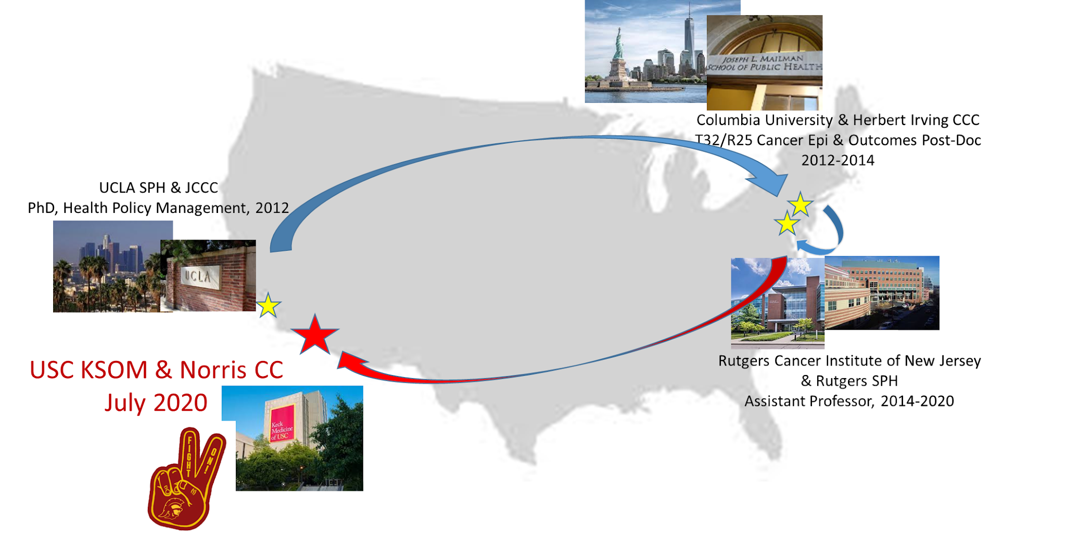
Jennifer Tsui, PhD, MPH
Associate Professor, Keck School of Medicine
Cancer Care Access, Quality & Outcomes
for Diverse Populations
Cancer Care Delivery
Health Systems & Policy
Diverse Populations
Equitable Dissemination and Implementation of EBP/EBI in Cancer Control

Slide 8




What are Evidence–Based Interventions (EBIs)?
Interventions, Tools, or Programs that are effective in changing outcomes (health outcomes or related behaviors/risk factors)
Examples:
Smoking cessation programs
Vaccination
Cancer Screening
Genetic Testing
Adherence to medication
Harm reduction programs
Physical activities
Healthy weight

Slide 9
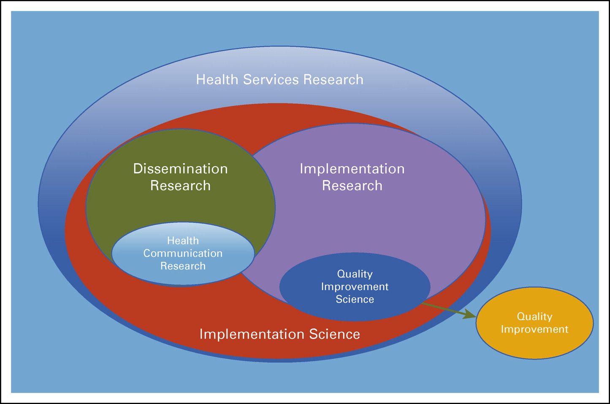
What is implementation science?
Science of understanding and improving the integration of evidence or evidence-based practices in the real world.
Understanding how to distribute evidence from research (dissemination)
Effectively incorporating new discoveries into real world settings (implementation)
Intervening on determinants through strategies that lead to implementation, adoption, practice change.
Published in: Sandra A. Mitchell; David A. Chambers; Journal of Oncology Practice 2017 13523-529.
DOI: 10.1200/JOP.2017.024729
Copyright © 2017 American Society of Clinical Oncology

Slide 10
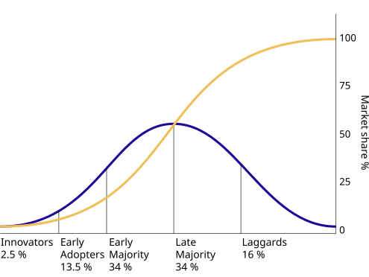
History of Dissemination and Implementation Science
Diffusion of Innovation: spread of new ideas (1960s)
Translational science gap: Bench to bedside; evidence-practice gap (1990s)
Implementation frameworks: RE-AIM (1999/2000)
NIH D&I Mental Health funding initiatives (2000)
Implementation science journal (2006)
Other national initiatives NIH, CDC, and AcademyHealth D&I Conference (2007 and beyond)
Diffusion of Innovations, Everett Rogers, first published in 1962

Slide 11

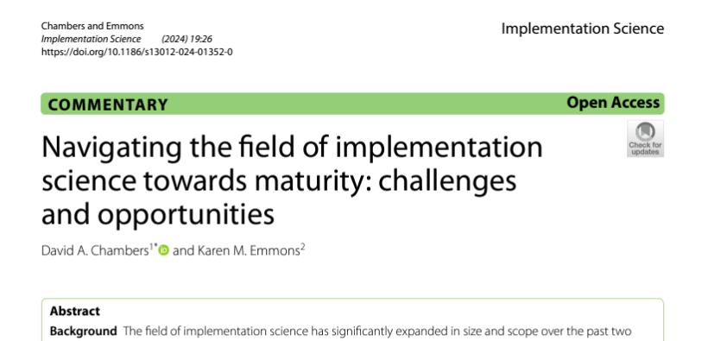

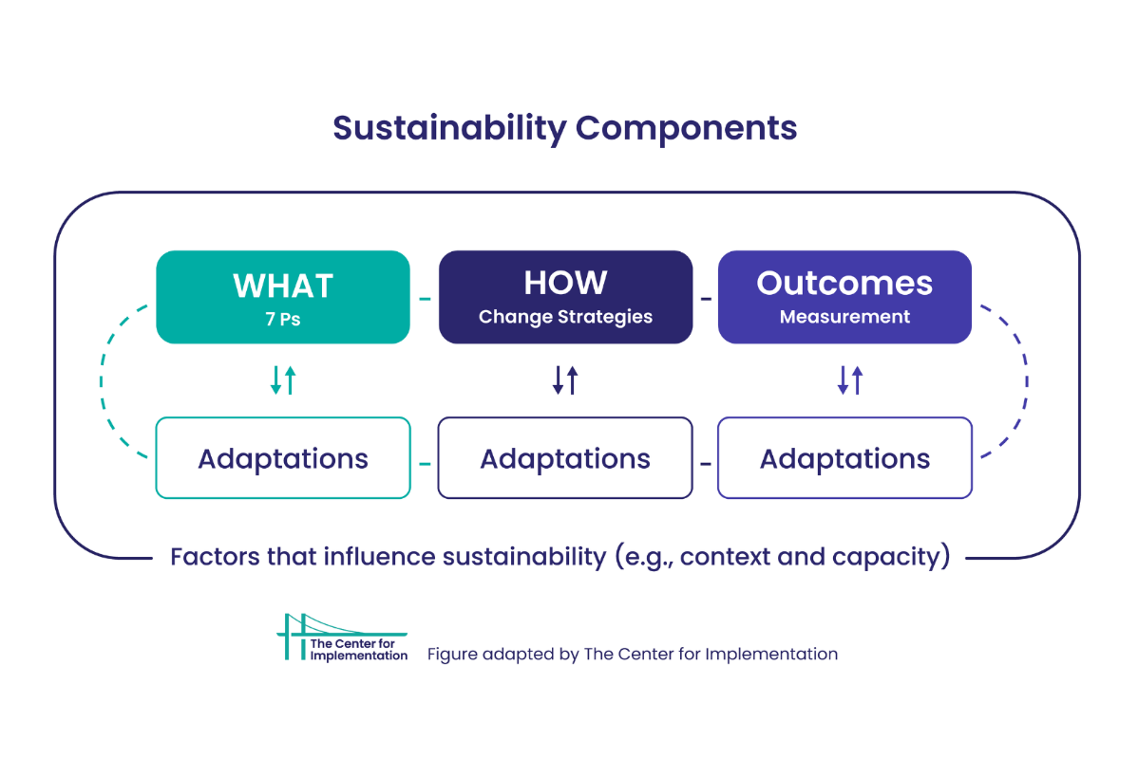
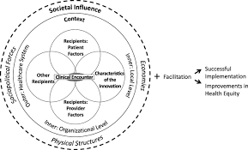
Dissemination and Implementation Science- Prior and Current Context
SETTINGS
POPULATIONS

Slide 12

Care occurs in context
National Health Policy Environment
State Health Policy Environment
Local Community Environment
Organization and/or
Practice Setting
Provider/Team
Family & Social
Supports
Individual
Patient
Improved Quality of Cancer Care
Improved Cancer-Related Health Outcomes
Stephen Taplin, Introduction: Understanding and Influencing Multilevel Factors Across the Cancer Continuum. NCI Multilevel Interventions in Health Care: Building the Foundation for Future Research Meeting, March 4, 2011

Slide 13
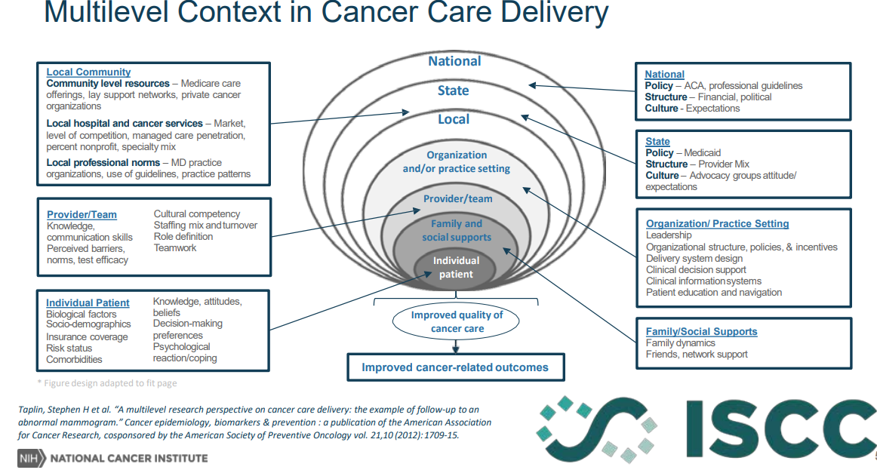

Slide 14
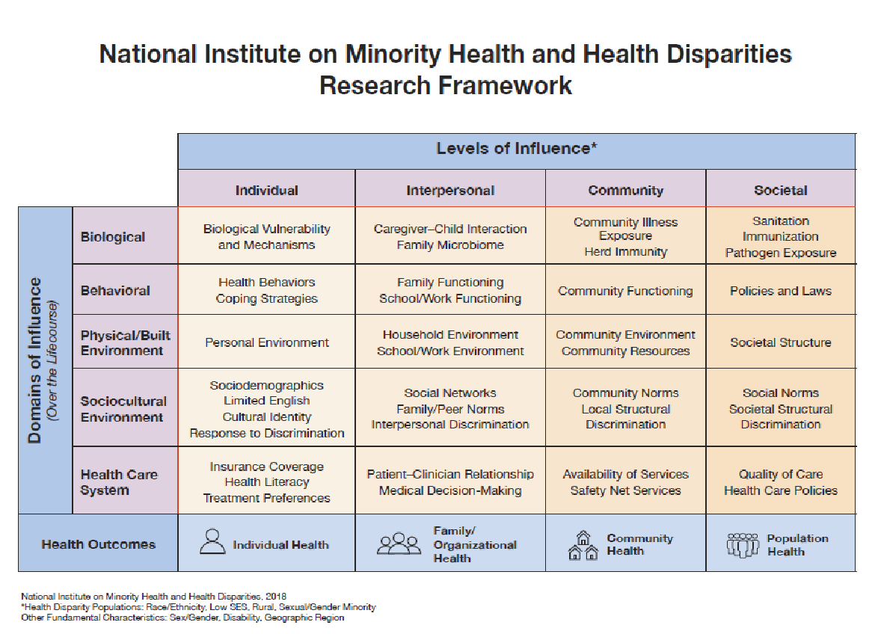

Slide 15
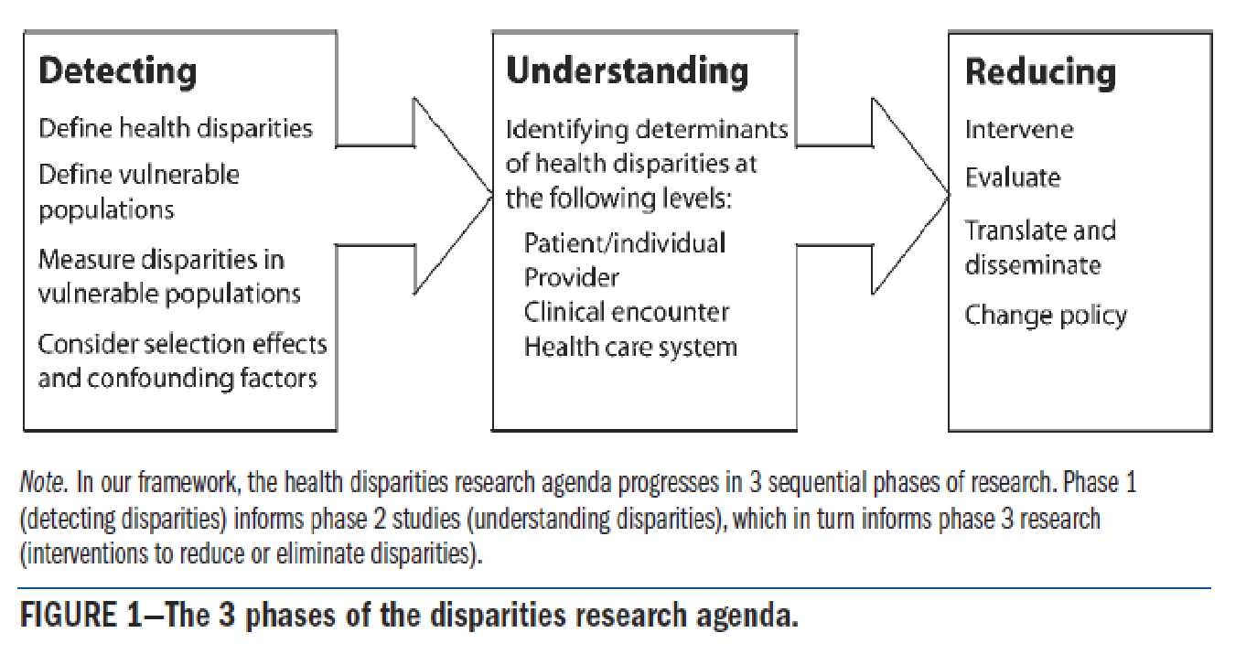
Health Disparities within Health System Framework (Kilbourne)
Kilbourne. AJPH, 2006

Slide 16
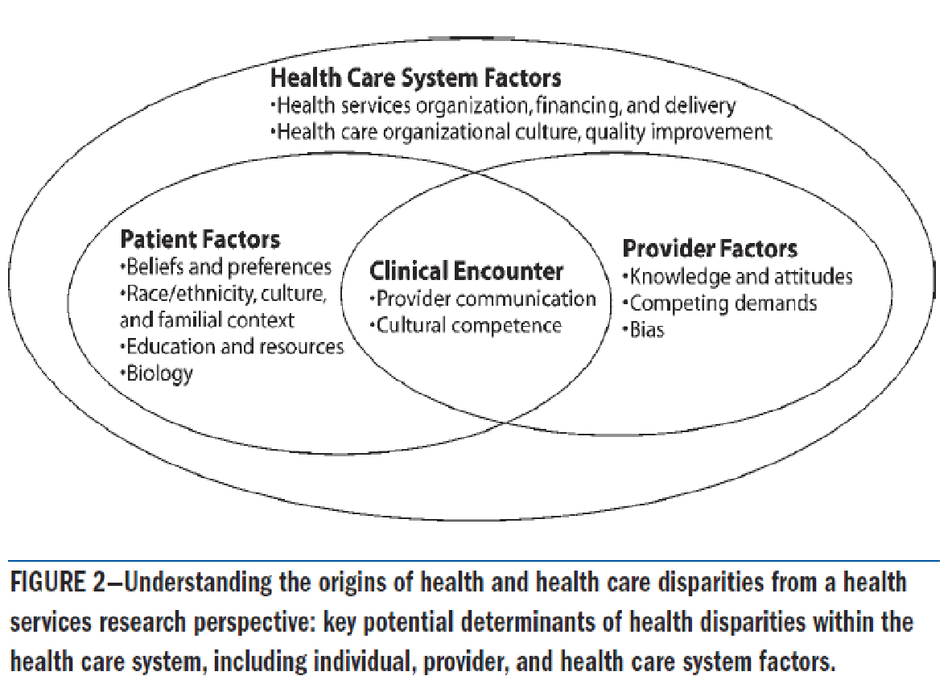
Health Disparities within Health Care Framework (Kilbourne)
Kilbourne. AJPH, 2006

Slide 17
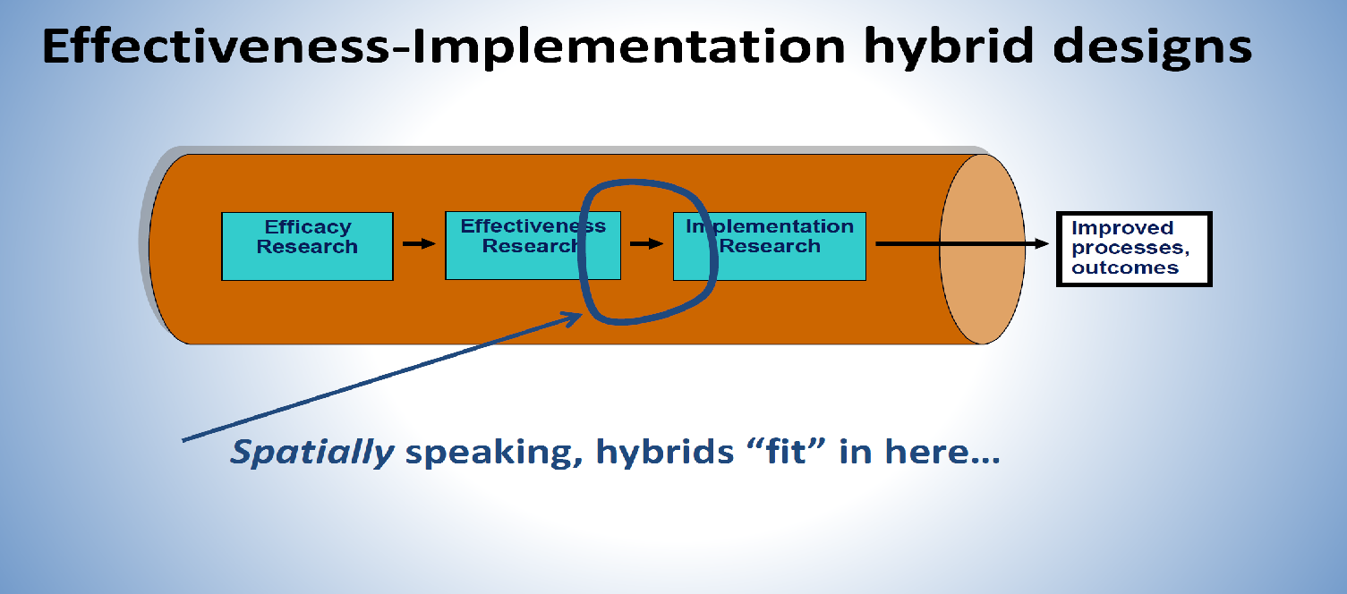
The Case for D&I Science to Address Health Disparities
Healthcare disparities are a special case of implementation failure (Woodward, 2019)
Few strategies targeting health disparities focus beyond patients and providers, to address system-level factors that also contribute to the problem (Chinman, 2017)
Emerging multilevel interventions have the potential to reduce health disparities (Chinman, 2017)
Implementation science offers methods to rigorously test these newer interventions to
assess if they should be replicated more broadly (Chinman, 2017)
‹#›

Slide 18
“PUBLICATION PATHWAY”
Balas & Boren, 2000
Original Research
18%
Dickersin, 1987
variable
Negative results
Submission
46%
It takes 17 years to turn 14 percent of original research to the benefit of patient care
Koren, 1989
0.5 year
Kumar, 1992
Acceptance
0.6 year
Kumar, 1992
Expert
opinion
Publication
Lack of numbers
35%
Balas, 1995
0.3 year
Poyer, 1982
Bibliographic databases
Inconsistent
indexing
50%
Poynard, 1985
6 - 13 years
Antman, 1992
Reviews, guidelines, textbook
9.3 years
Implementation

Slide 19
Studying Implementation
THE CORE OF
IMPLEMENTATION RESEARCH
Implementation Outcomes
Feasibility
Fidelity
Penetration
Acceptability
Sustainability
Uptake
Costs
Service
Outcomes*
Efficiency
Safety
Effectiveness
Equity
Patient-
centeredness
Timeliness
Health Outcomes
Satisfaction
Function
Health status/
symptoms
What?
How?
THE USUAL
QIs
Implementation
ESTs
Strategies
*IOM Standards of Care
Implementation Research Methods
Proctor et al 2009 Admin. & Pol. in Mental Health & Mental Health Services Research

Slide 20
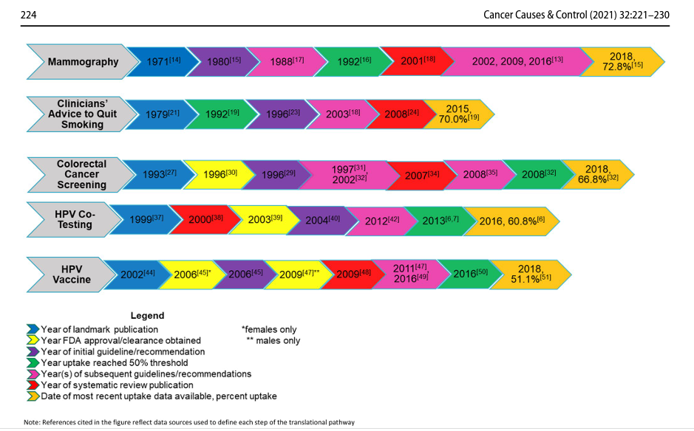
Time to Translation of Evidence-Based Practices in Cancer Control

Slide 21
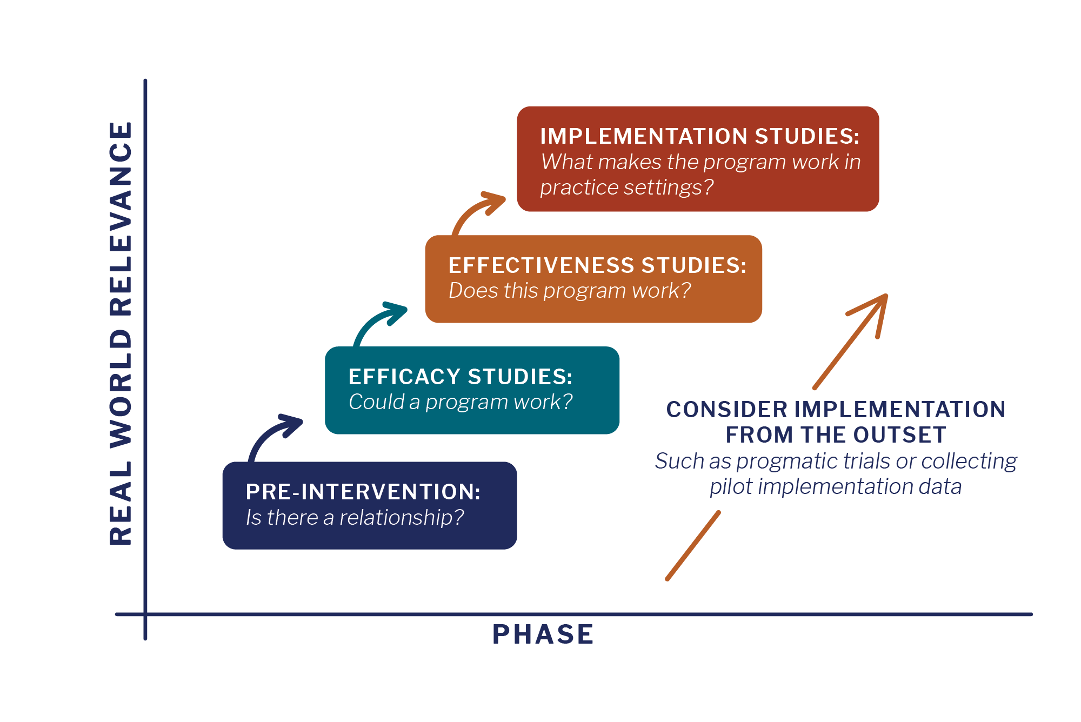

Slide 22
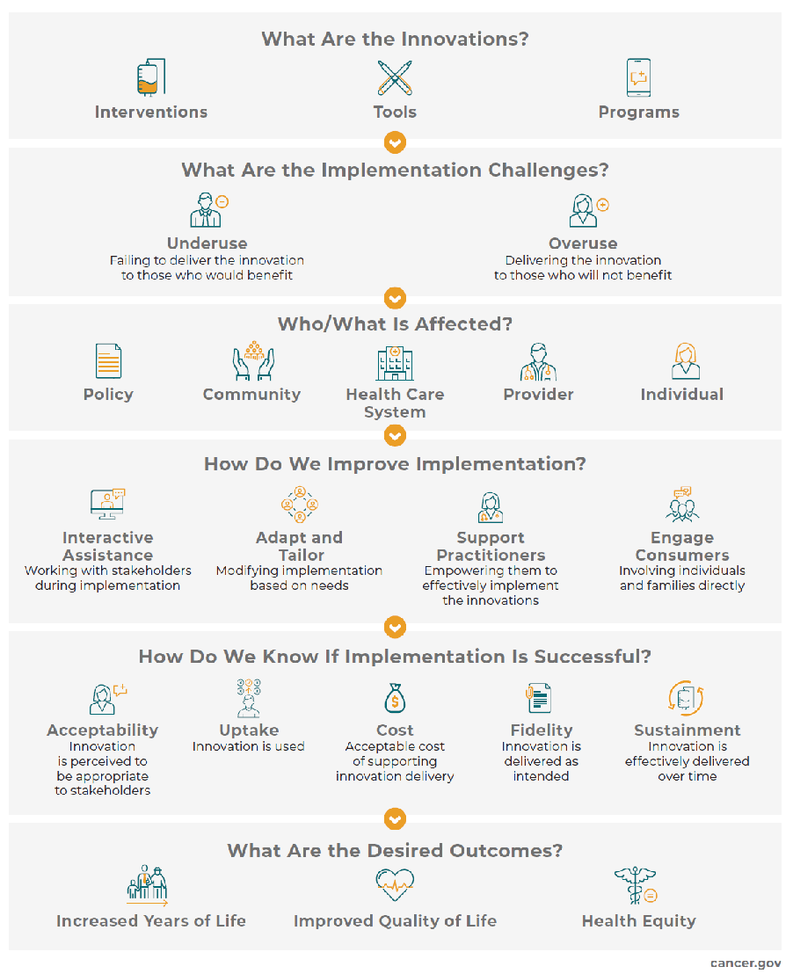
Are innovations addressing or exacerbating disparities?
Are there inequalities that are part of the context creating barriers?
Equitable
Implementation
Are there opportunities to engage key Community Partners?
“Equitable implementation
occurs when strong equity components (including explicit attention to the culture, history, values, and needs of the community) are integrated into the principles and tools of implementation science to facilitate quality implementation of effective programs for a specific community or group of communities.”
What are culturally, historically, and contextually appropriate strategies for people/places do the thing?
How much and how well was the innovation implemented? Who benefits?
Evaluation of Disparities and Equity based on common definitions

Slide 23
1. Evaluation and iterative strategies
2. Interactive assistance
3. Adapting and tailoring to context
4. Develop stakeholder relationships
  Assess readiness
  Identify barriers and facilitators
  Facilitation
  Technical assistance
  Tailor strategies
  Promote adaptability
  Identify local opinion leaders
  Build coalitions
5. Train/educate stakeholders
6. Supporting clinicians
7. Engage consumers
8. Use financial strategies
9. Change infrastructure
  Conduct training
  Develop educational materials
  Audit and feedback
  Revise professional roles
  Involve end-users
  Use mass media
  Alter incentive structures
  Develop disincentives
  Mandate change
  Change physical structures
Slide credit: P Adsul, W. Norton
Slide credit: P Adsul, W. Norton

Slide 24



How do we fit effective strategies into the settings (contexts) that need it most?
Health and healthcare inequities disproportionately burden medically underserved communities and patients in low resource settings
Public health systems:
Primary source of patient care for over 20 million Zambians
Optimal setting for evidence-based prevention that advances health equity

Slide 25
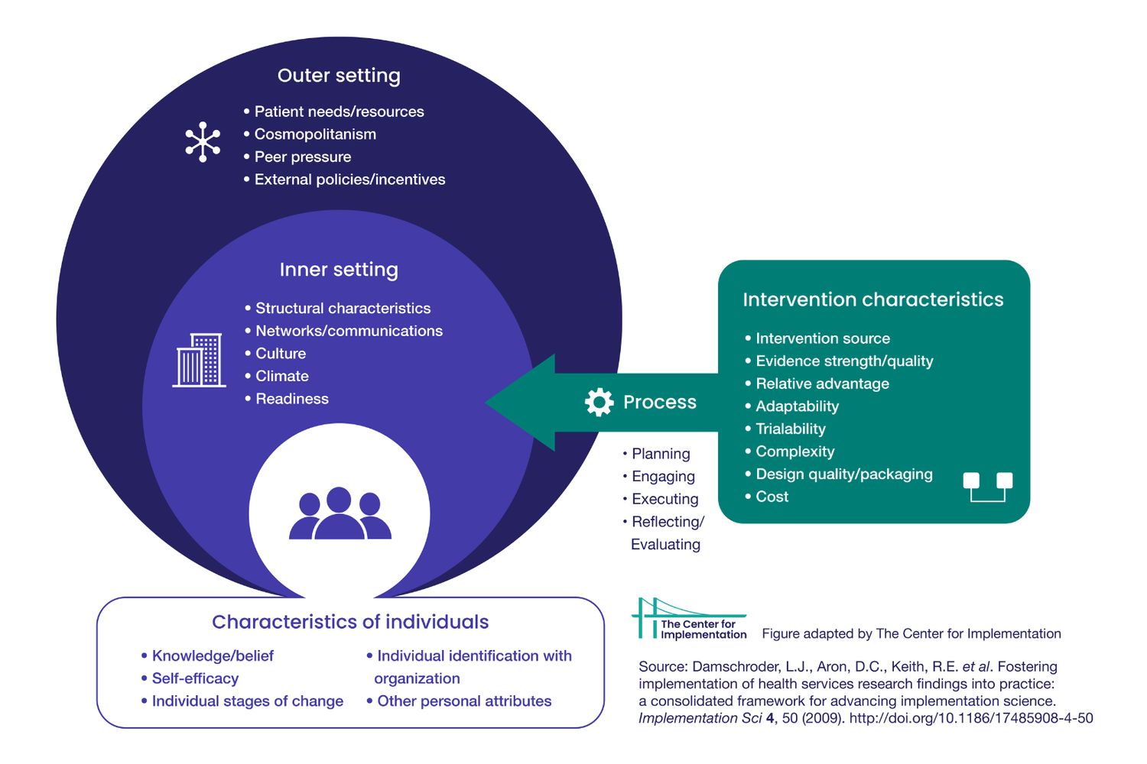
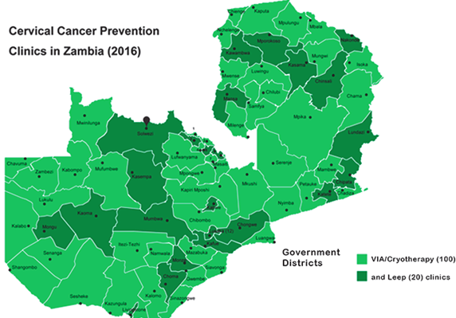


Adaptation of evidence-based interventions and strategies for diverse communities and clinical settings

Slide 26
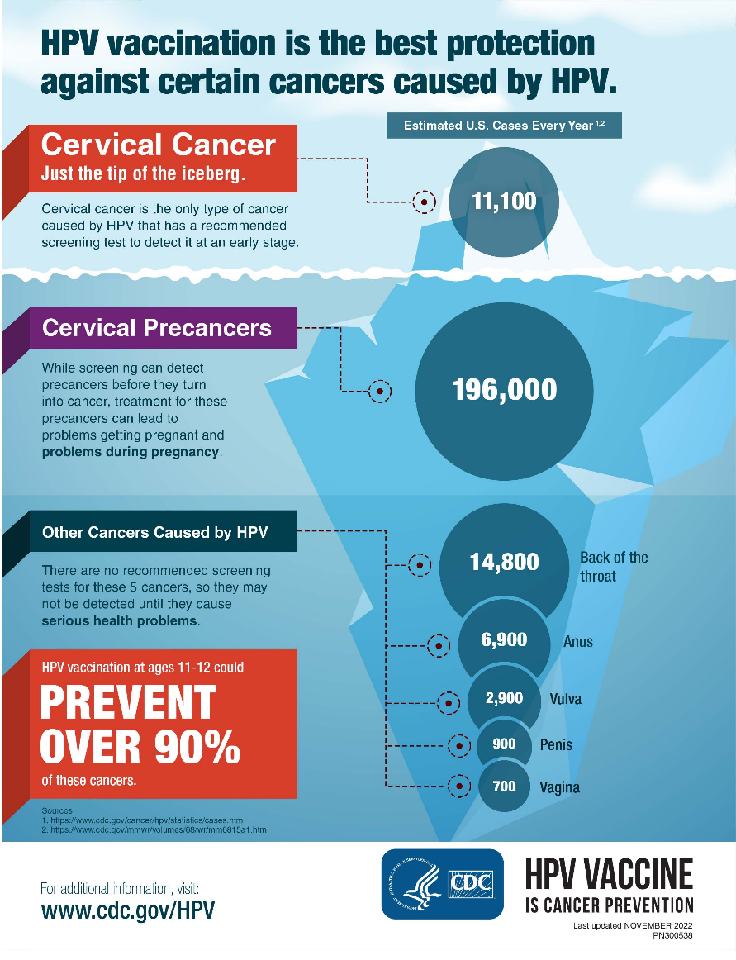
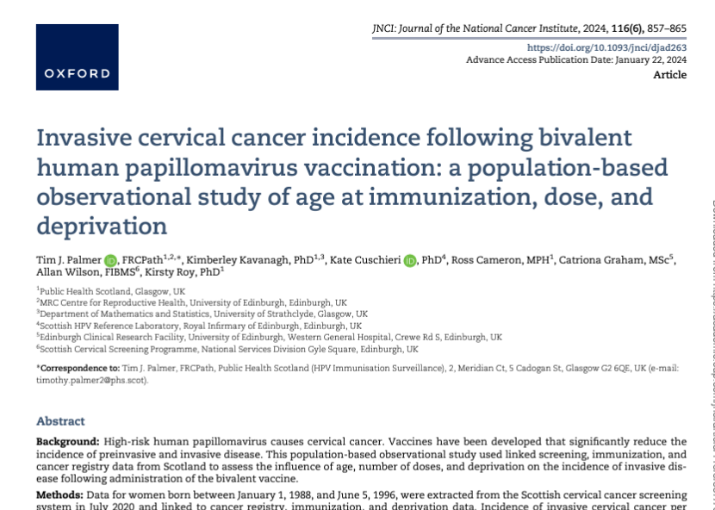

HPV and HPV Vaccines
1st HPV vaccine became available in 2006 and over 300 million doses have been distributed since then.
Currently Gardasil®️ 9 is FDA approved for everyone ages 9-45 and protects against 9 HPV high risk types
Advisory Committee on Immunization Practices (ACIP) routinely recommends starting the HPV vaccine at age 11 or 12, but can be given as early as age 9​
Notes:
9,102 women
Rates: NCQA: 36.9% for adolescents on Medicaid
Healthy People 2030 goal: 80%
80% of people will get an HPV infection in their lifetime
Most HPV infections go away by themselves
Some can lead to cancer
There are more than 100 types of HPV
Some can cause warts on the skin

Slide 27





Key Approaches for Implementation Science to Address Cancer Equity
Equity focus at multiple levels
Engagement with key partners
Multidisciplinary team
Importance of Context
Sustainability and adaptation over time

Slide 28
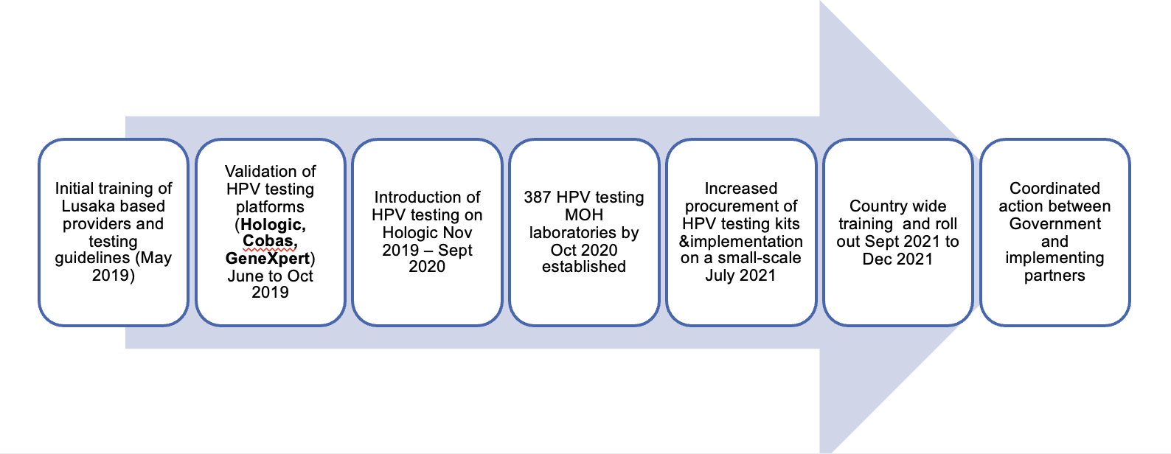
Local Evidence-Based Practices
Evolvement of the HPV screening program in Zambia

Slide 29
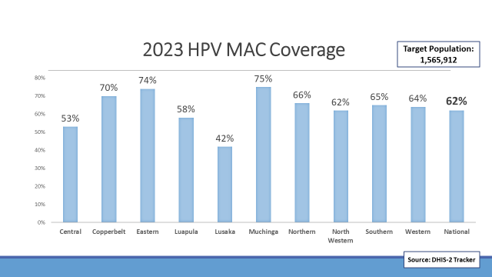
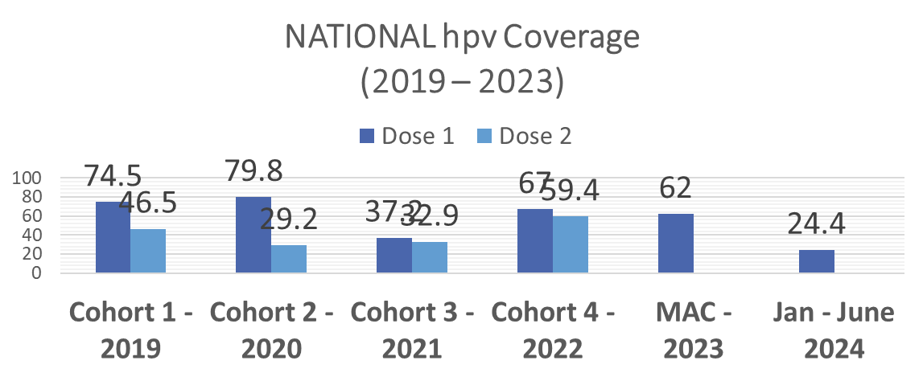

Improving HPV Vaccination is Critical for Cancer Equity in Zambia

Slide 30
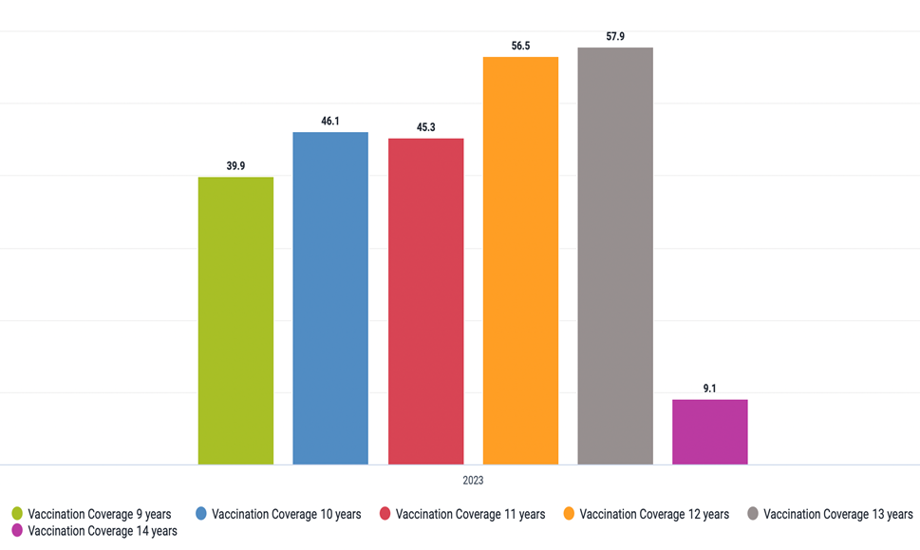
Vaccination coverage among 11-12 yr olds across the country during MAC
Notes:
Sample size per clinic ranged from ~2000-3500 patients

Slide 31
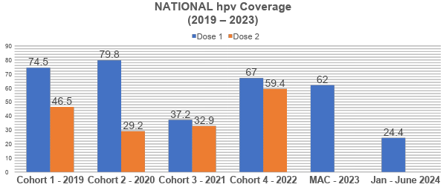
National HPV Vaccine Coverage
Source: Program Reports

Slide 32
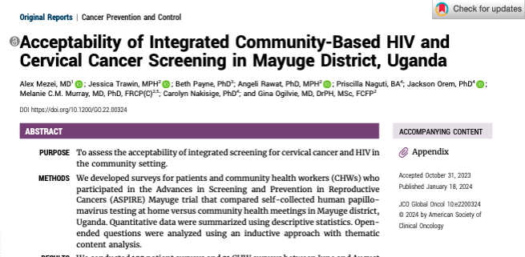

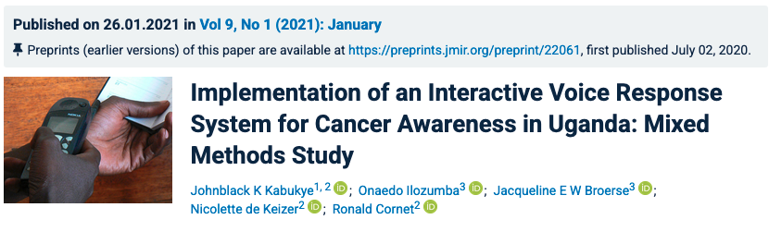

Slide 33
Thank you for your participation!
Preparing for Module 2
Next Session: We will dive deeper into barrier/facilitator analysis
Post-training Activity: Please complete the worksheet being sent by email after today’s session

Slide 34
Module 2

Slide 35
Module 2 Goals
Identify how various contextual factors, referred to as barriers and facilitators, can influence the success of implementing evidence-based interventions for cancer prevention/care within HIV clinics
Apply implementation science theories, models, and frameworks to inform the identification of barriers and facilitators.
Develop contextually appropriate strategies to address identified barriers and enhance facilitators.

Slide 36
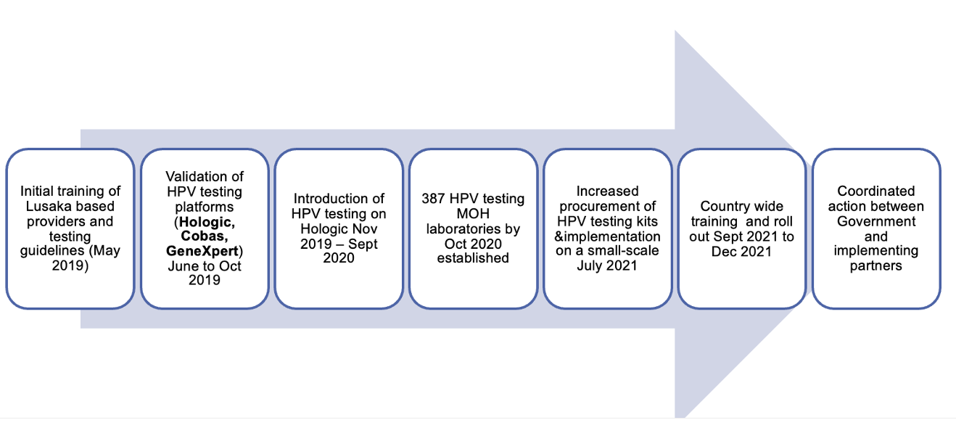
Cancer Prevention EBIs in the Local Context
Evolvement of the HPV screening program in Zambia

Slide 37
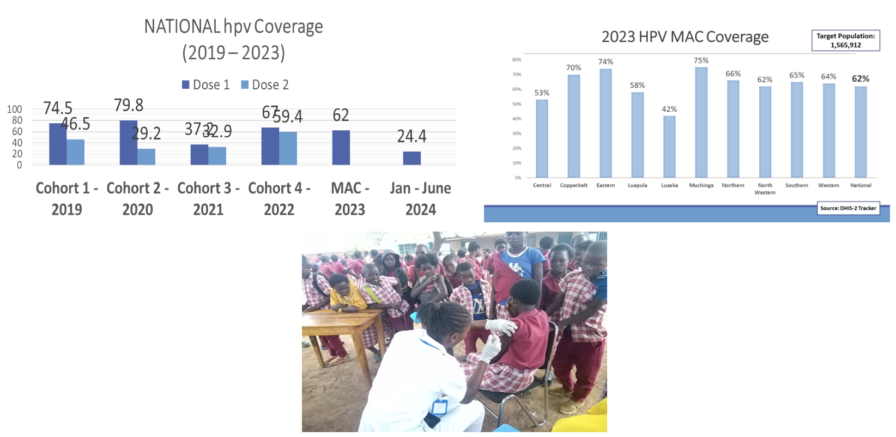
HPV Vaccination in Zambia

Slide 38
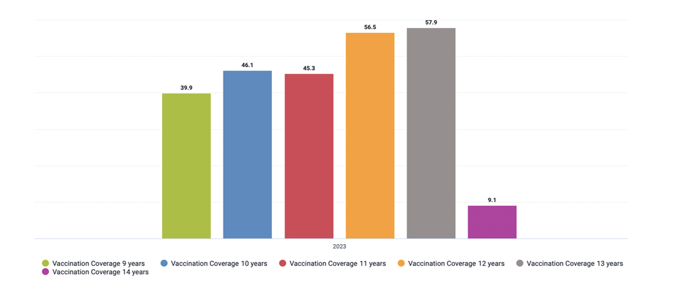
Vaccination Coverage
Vaccination coverage among 11-12-year-olds across the country during MAC
Notes:
Sample size per clinic ranged from ~2000-3500 patients

Slide 39
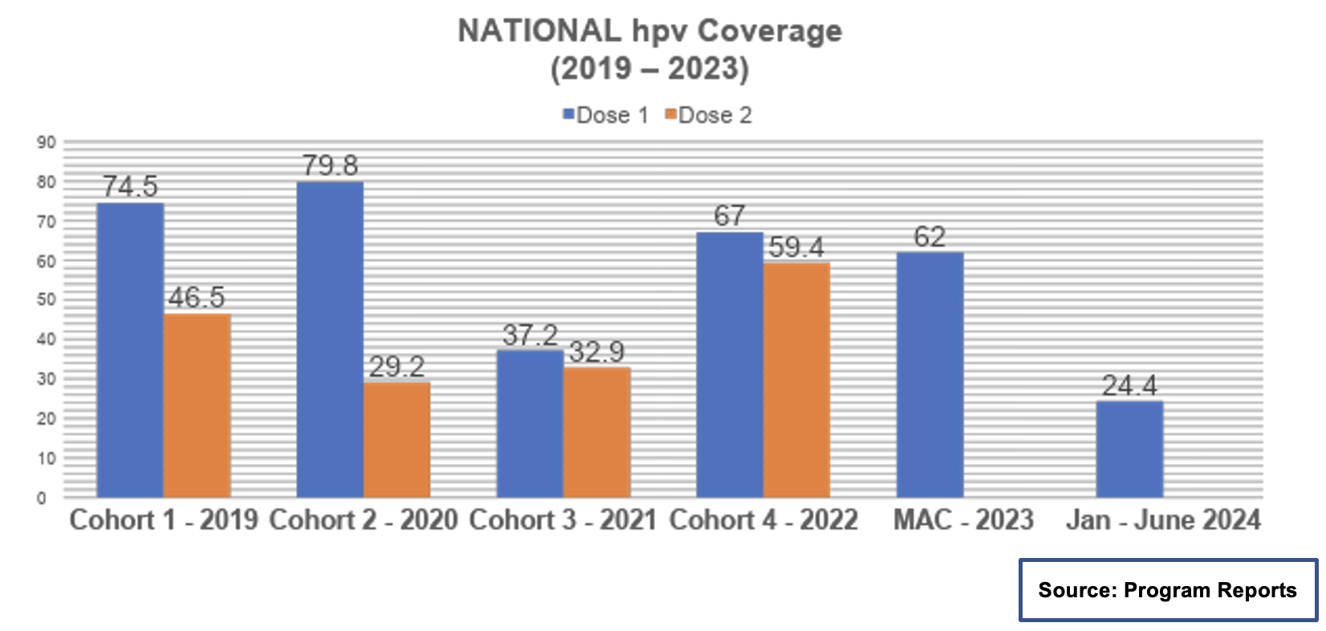
National HPV Vaccine Coverage

Slide 40
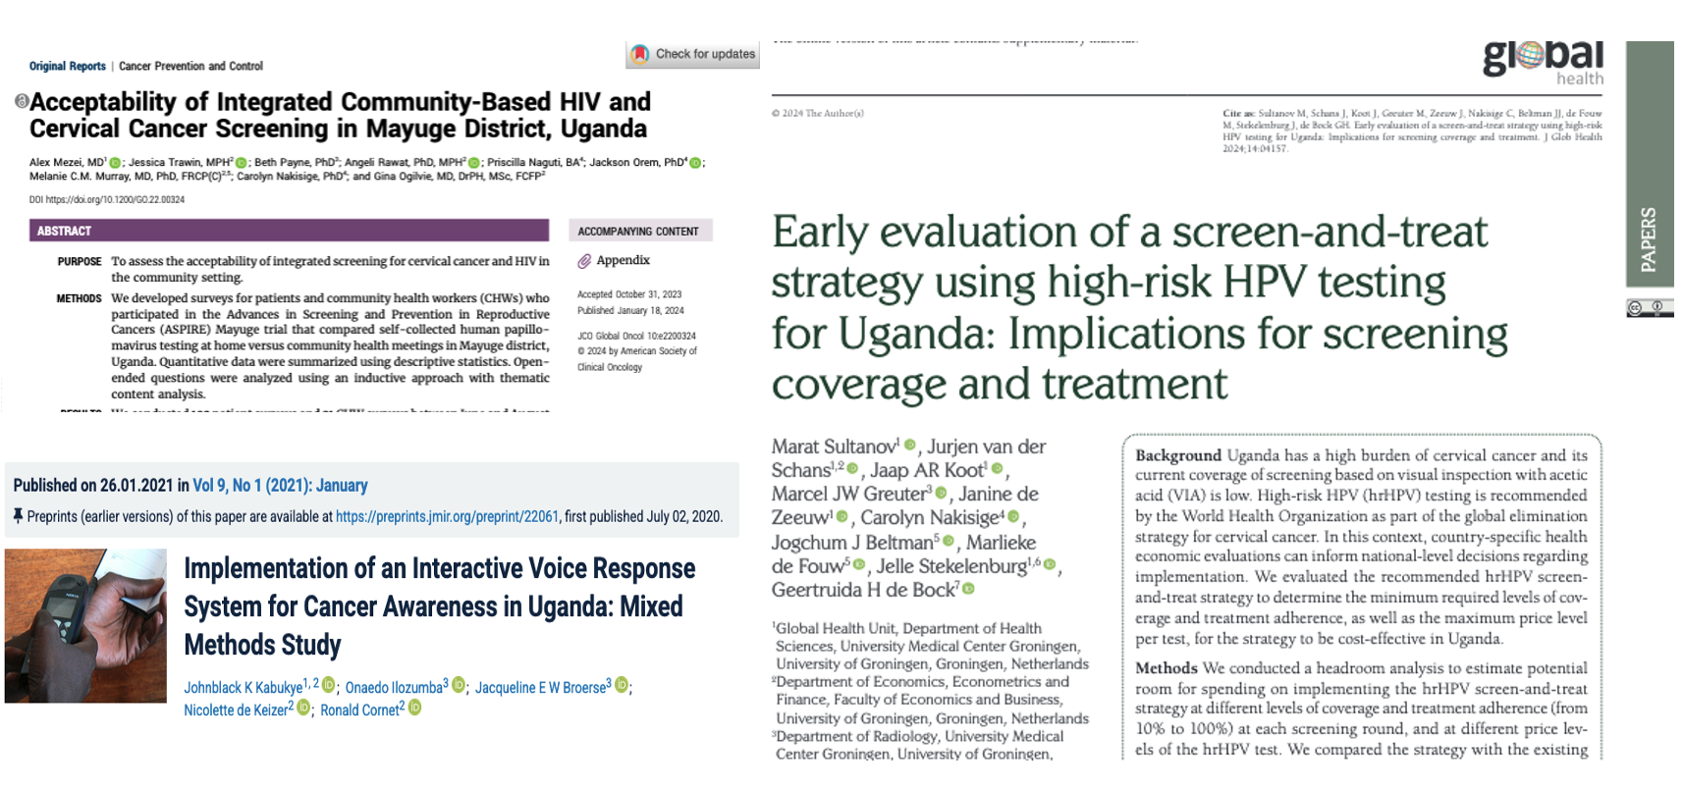
EBIs in Uganda

Slide 41
Implementing Evidence-Based Interventions:
Strategies and Identification of Facilitators and Barriers

Slide 42
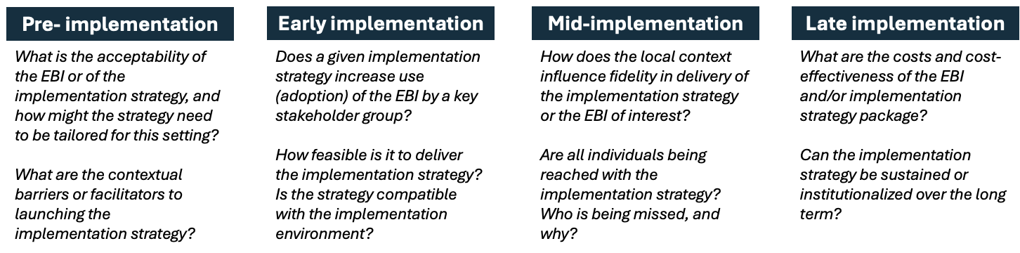
Evaluation Questions
Implementation science is primarily focused on evaluating implementation strategies used to deliver evidence-based interventions.
Evaluation questions will necessarily be different at different stages of implementation.
Examples include:

Slide 43
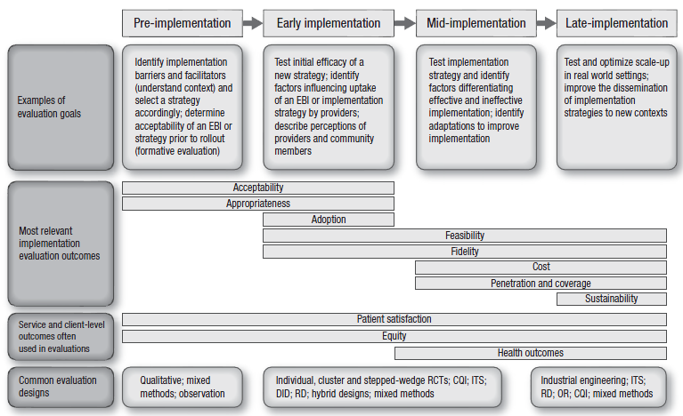
Evaluation Questions and Designs

Slide 44
Key Concepts
  Evaluating implementation is necessary for improving program effectiveness and optimizing efficiency. Key steps in designing an implementation evaluation include:
  Develop the evaluation question. These questions necessarily vary by stage: pre-implementation, early or mid-implementation, and late implementation.
Step 1
Step 2
  Identify an implementation science framework to guide an evaluation, if helpful to the study.
Step 3
  Choose an evaluation design that balances the desire for scientific rigor and strength of evidence with pragmatic considerations such as ethics, timing, study feasibility, and budget.

Slide 45
Theories and Frameworks
Why do we need theoretical and conceptual frameworks to address public health issues?
A theory presents a systematic way of understanding events, behaviors, and/or situations.
A theory is a set of interrelated concepts, definitions, and propositions that explain or predict events or situations by specifying relations among variables.
Generality, or broad application, is important. Theories are, by their nature, abstract and not content- or topic-specific

Slide 46
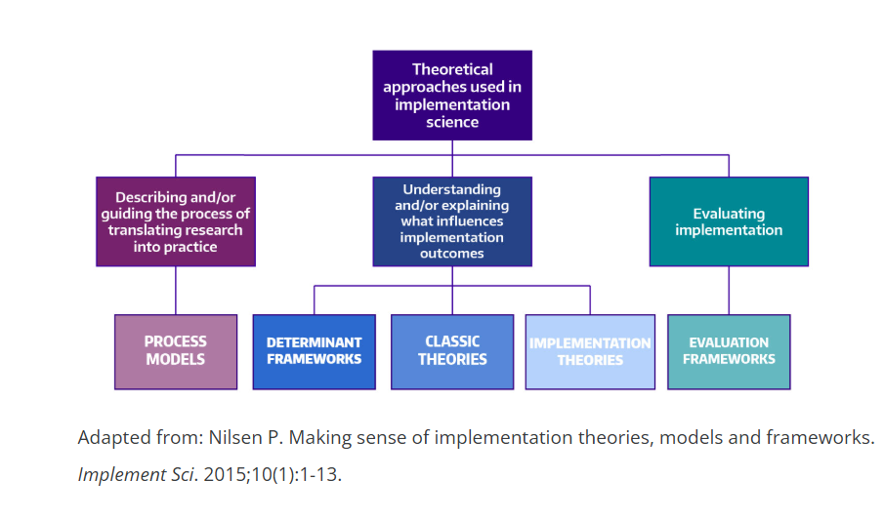
TMF in Implementation Science
Process Models
Determinant Frameworks
Classic Theories
D&I Theories
Evaluation Frameworks

Slide 47
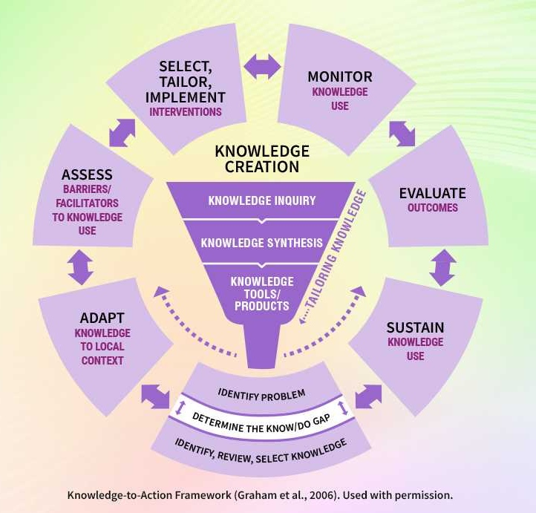
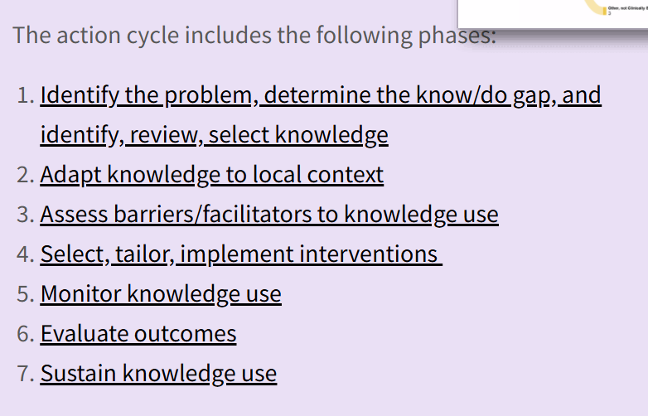
Knowledge to Action Framework
https://rnao.ca/bpg/leading-change-toolkit/knowledge-to-action-framework

Slide 48
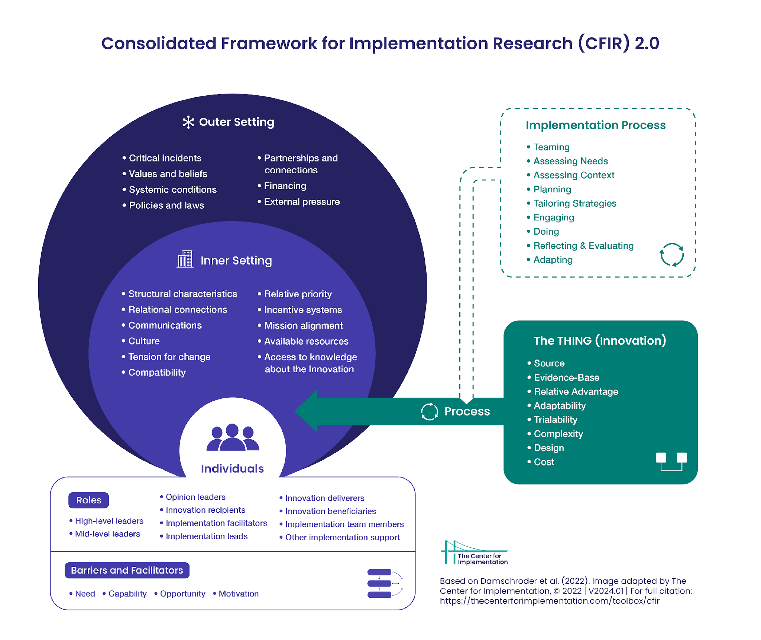

Slide 49
Implementation Strategies
Evidence-based interventions are programs, practices, principles, procedures, products, pills, or policies that have been demonstrated to improve health behaviors, health outcomes, or health-related environments.
Implementation strategies are the actions taken to enhance the adoption, implementation, and sustainability of evidence-based interventions.
Example: Evidence-based intervention: routine childhood vaccination
Implementation strategies: stakeholder engagement through working with local opinion leaders, or increasing community knowledge on vaccines through a series of community forums

Slide 50
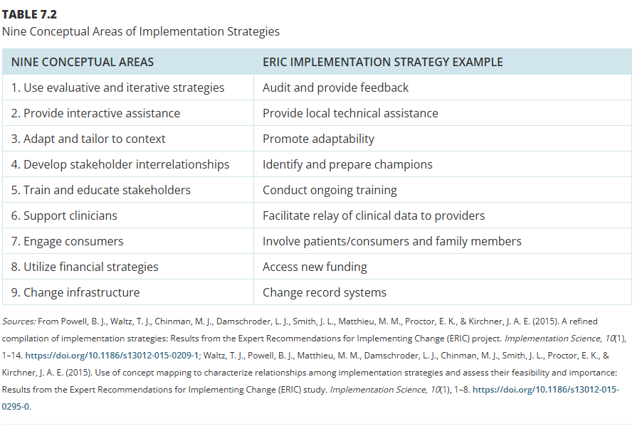

Slide 51
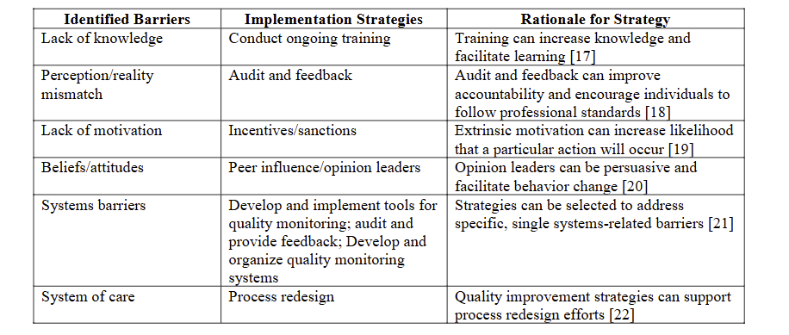

Slide 52
Identifying Implementation Strategies
Implementation Mapping multi-step process that includes
identifying determinants that need to be addressed with a strategy and what change is needed,
describing potential mechanisms of change and which implementation strategies could be used
prioritizing strategies based on team/organizational input or pilot data, as well as feasibility.
*Concept Mapping
*Delphi Method
*Implementation Planning Logic Model
https://obssr.od.nih.gov/sites/obssr/files/Social-and-Behavioral-Theories.pdf

Slide 53
Defining Context
Factors that influence implementation are often referred to as barriers and facilitators, or context.
When determining which contextual factors will or did influence implementation, keep in mind that:
Context is multilevel,
Contextual factors can serve as barriers or facilitators to implementation,
Context can change over time, and
Some contextual factors are modifiable, others are not.

Slide 54
Determining Barriers and Facilitators
There are systematic ways to identify and prioritize potential barriers and facilitators to implementation.
Community and stakeholder engagement should be integrated with four main core processes:
Brainstorm potential barriers and facilitators (based on experience, past needs assessments, and published literature)
Use theories, models, and frameworks to identify potential barriers and facilitators
Collect new data (qualitative and quantitative) to assess barriers and facilitators
Prioritize the most important and changeable factors
Fernandez, M. E., Damschroder, L., & Balasubramanian, B. (n.d.). Chapter 5: Understanding barriers and facilitators for implementation across settings [PowerPoint slides]. In B. J. Weiner, C. C. Lewis, & K. Sherr (Eds.), Practical implementation science: Moving evidence into action.

Slide 55
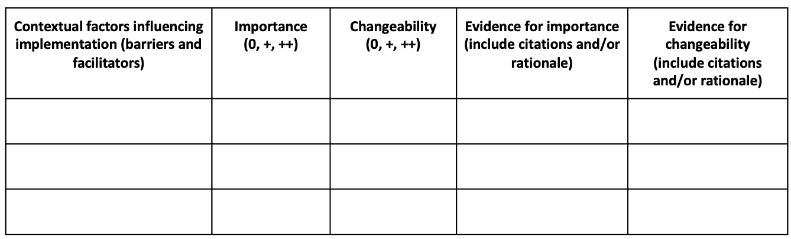
Prioritizing Barriers and Facilitators
You can prioritize barriers and facilitators by rating each determinant in terms of importance or relevance (strength of association with the outcome) and changeability (how likely it is that the intervention will influence change in the determinant):
Fernandez, M. E., Damschroder, L., & Balasubramanian, B. (n.d.). Chapter 5: Understanding barriers and facilitators for implementation across settings [PowerPoint slides]. In B. J. Weiner, C. C. Lewis, & K. Sherr (Eds.), Practical implementation science: Moving evidence into action.

Slide 56
Module 3

Slide 57
Module 3 Goals
Apply the Implementation Research Logic Model to organize barriers, facilitators, and strategies for evidence-based interventions in HIV clinics.
Develop an implementation plan that specifies goals, strategies, stakeholders, responsibilities, and timelines for action.
Strengthen skills in stakeholder engagement, communication, and dissemination to support implementation and sustainability.

Slide 58
Training 2 Activity Review

Slide 59
Module 3: Developing an Implementation Plan

Slide 60
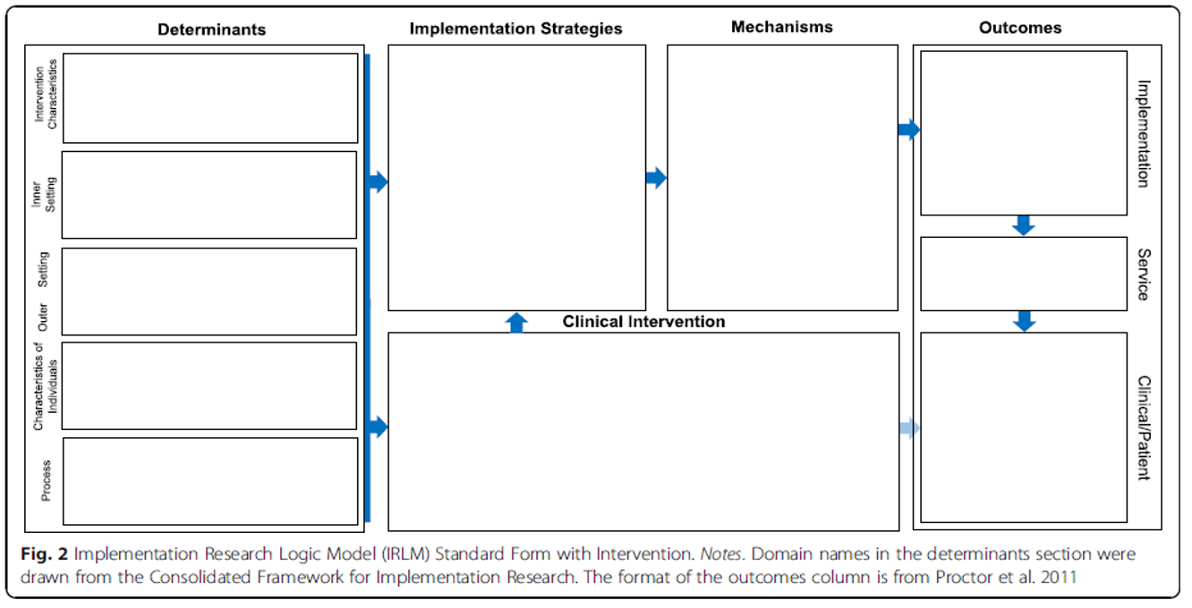

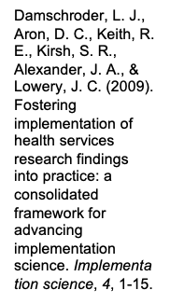
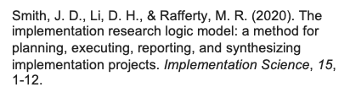
Implementation Research Logic Model

Slide 61
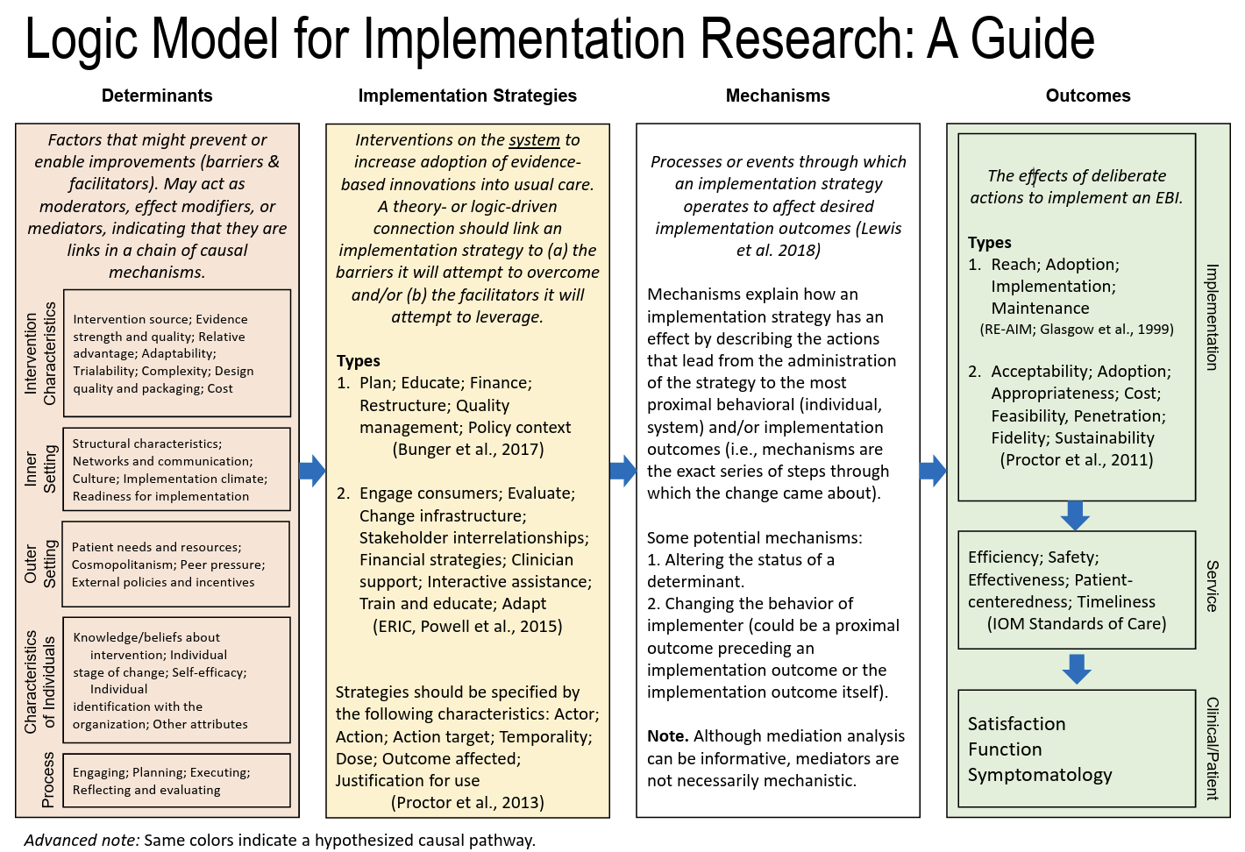
Smith, J.D., Li, D.H. & Rafferty, M.R. The Implementation Research Logic Model: a method for planning, executing, reporting, and synthesizing implementation projects. Implementation Sci 15, 84 (2020). https://doi.org/10.1186/s13012-020-01041-8

Slide 62
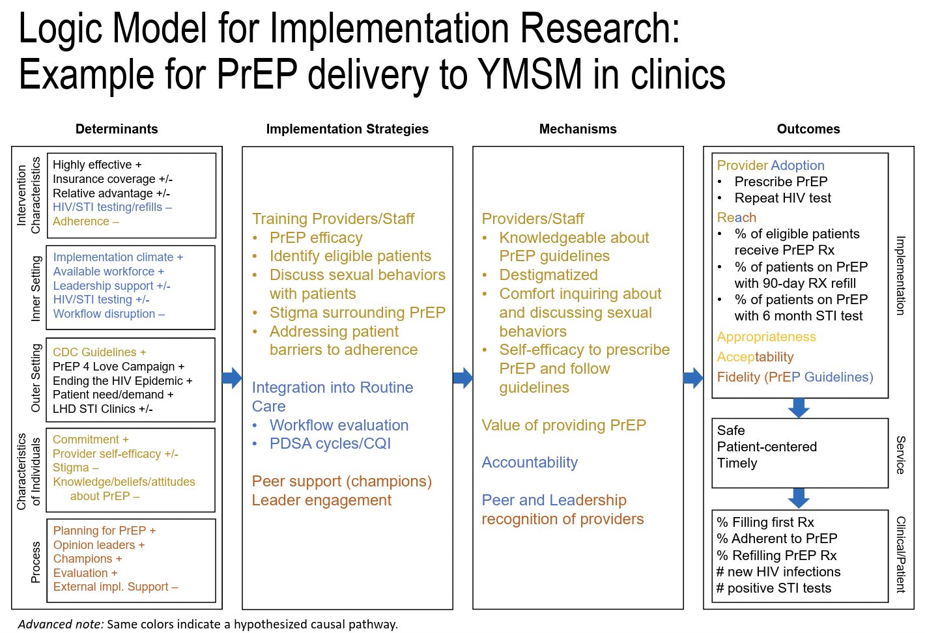
Smith, J.D., Li, D.H. & Rafferty, M.R. The Implementation Research Logic Model: a method for planning, executing, reporting, and synthesizing implementation projects. Implementation Sci 15, 84 (2020). https://doi.org/10.1186/s13012-020-01041-8

Slide 63
Module 3: Developing an Implementation Plan

Slide 64
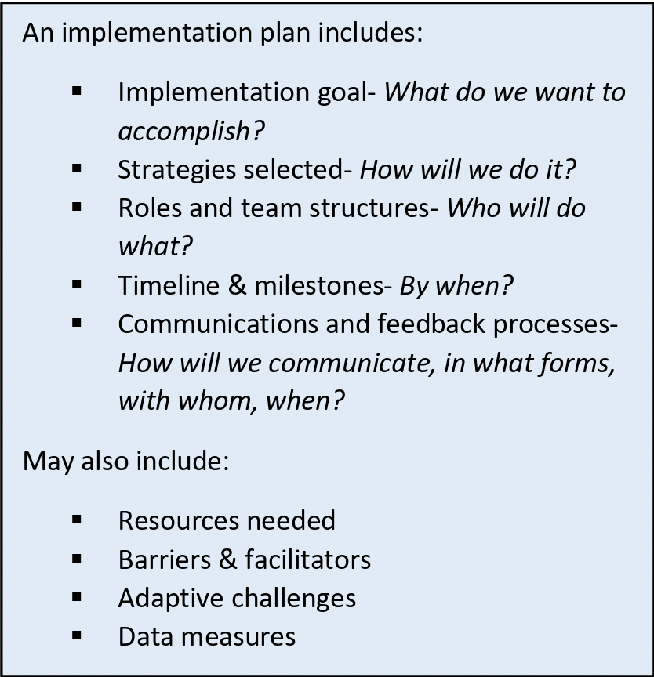
What is an Implementation Plan?
An implementation plan is a planning tool used to document key aspects guiding a change effort, including implementation goals, strategies used, person(s) responsible, and timeline.
Ideally, implementation plans document the work to be done so that everyone is clearly aware of the scope, roles, responsibilities, data monitoring, communications, time frames, team structures, and related aspects.
Collaborative for Implementation Practice (2024, 28 February). Implementation Plan Template and Examples. https://www.implementationpractice.org/wp-content/uploads/2021/05/NIRN-CIP-Implementation-Plan-Templateand-Examples-fillable-v1.pdf

Slide 65
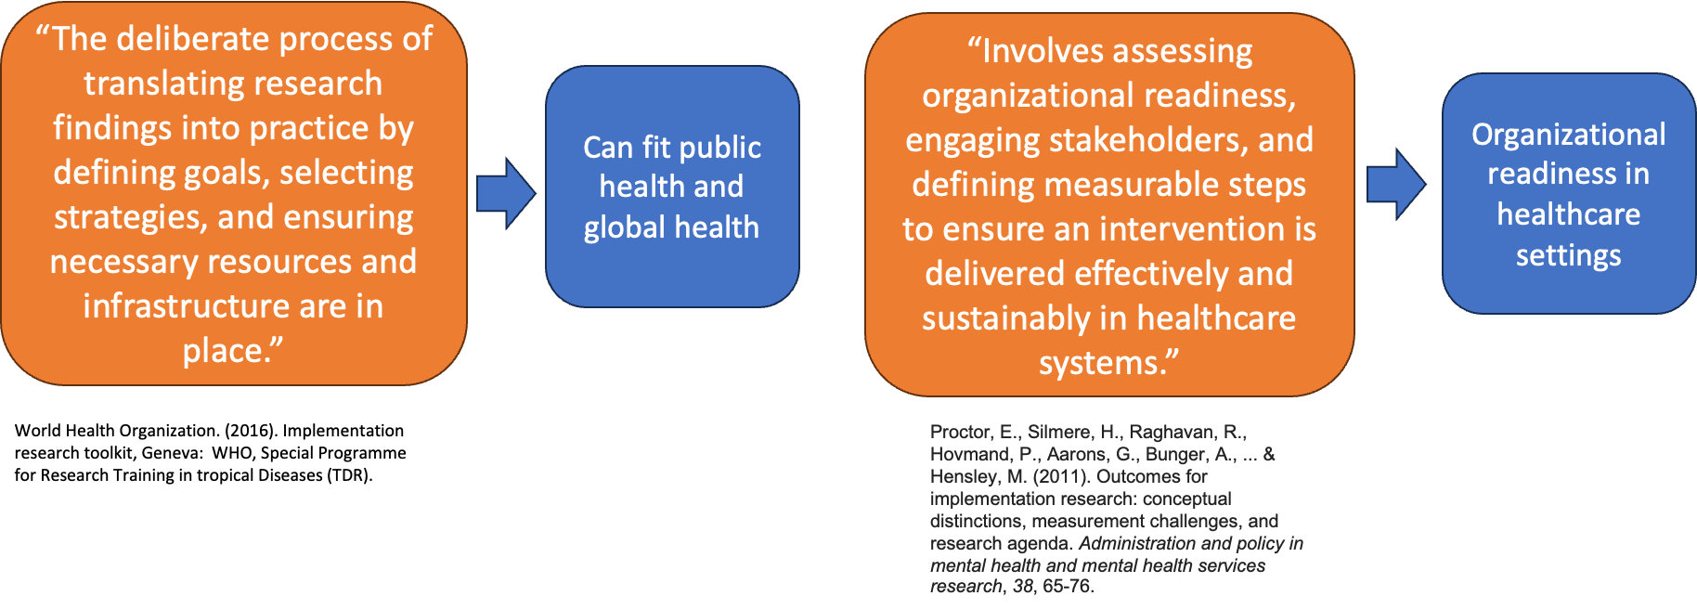
Definitions in Implementation Planning

Slide 66
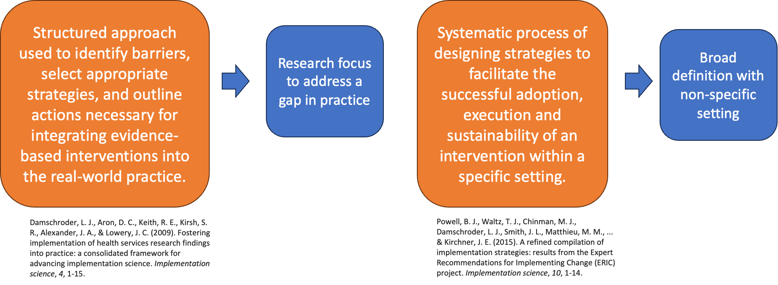

Slide 67
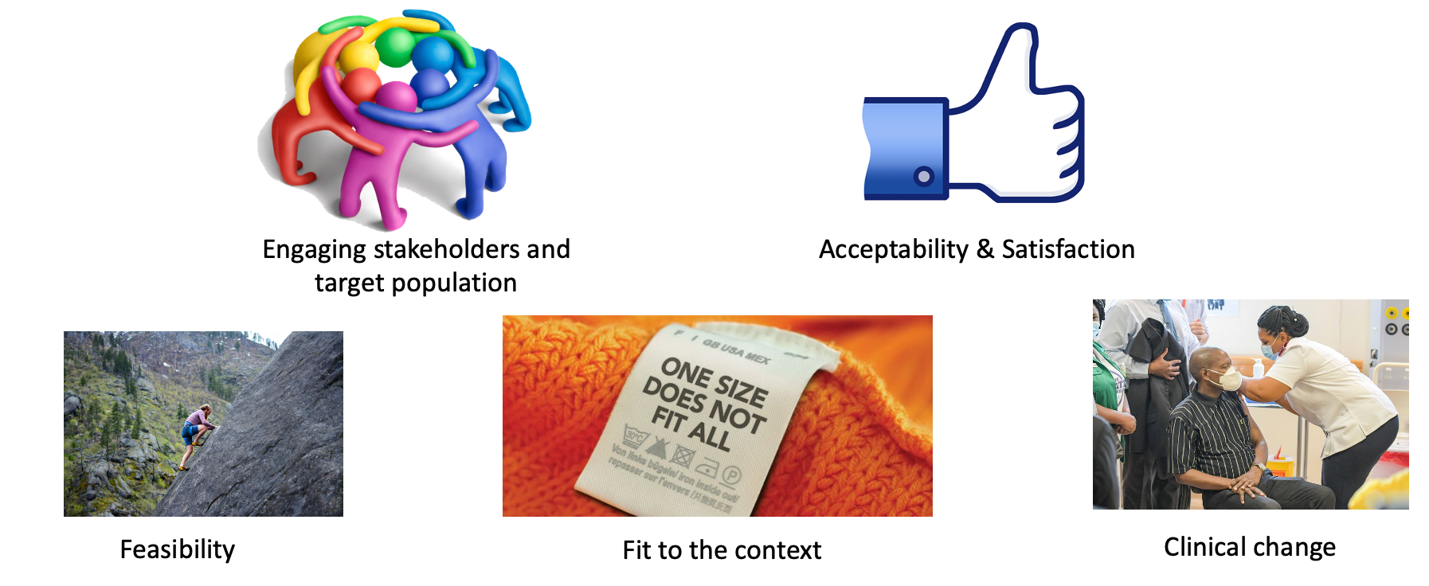
Things to Consider

Slide 68

Who should be involved?
The process of creating an implementation plan is best done collaboratively and co-created with those who will have a role in the implementation of the new program or practice and those who will be impacted by the change.
Stakeholders are people, communities, and organizations that could be affected by a situation. While internal stakeholders participate through coordinating, funding, and supporting implementation efforts, external stakeholders contribute views and experiences in addressing the issues important to them as patients, participants, and members of the community.
Remember that stakeholder engagement is necessary throughout the entire implementation process. These questions can help guide you as you move through the assess, prepare, implement, and evaluate stages.
Implementation Science Team (Division of Cancer Control and Population Sciences). (2022). Implementation science at a glance: A guide for cancer control practitioners (NIH Publication No. 19-CA-8055). National Cancer Institute, U.S. Department of Health and Human Services. https://cancercontrol.cancer.gov/sites/default/files/2020-04/NCI-ISaaG-Workbook.pdf

Slide 69
Questions/Discussion

Slide 70
Thank You! Weeble! Natotela!
For More information, please contact:
jimarinaitwe@gmail.com

